Slide 1
Fire Assessment: Overview and Introduction

Slide 2
Course Outline
3 to 4 hour course.
Designed for BCWS staff, contract crew leaders and forest industry personnel.
Recognized as the minimum training for fire assessment by firefighters.
Evaluation Criteria:
- Written Exam worth 70 %.
- Fire Assessment Activity 30 %.

Slide 3
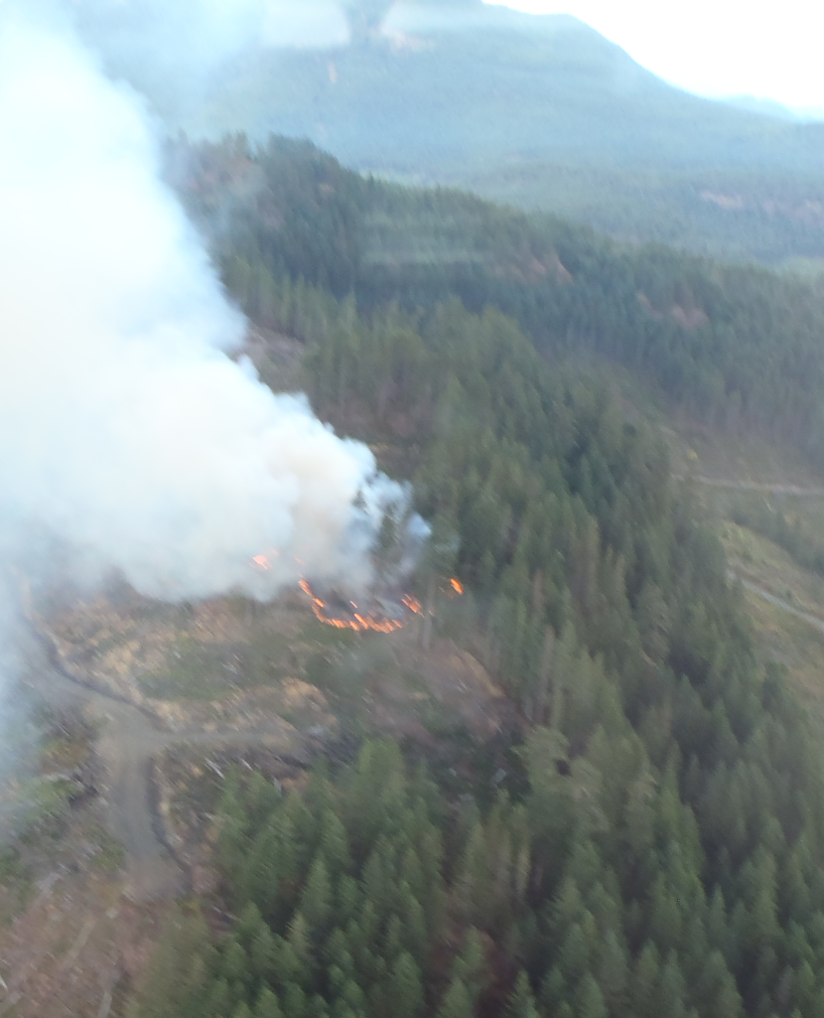
Learning Objective
Upon completion of this course, the trainee will develop the working knowledge and the ability required to complete and deliver an accurate fire assessment.
Observe the Fire

Slide 4
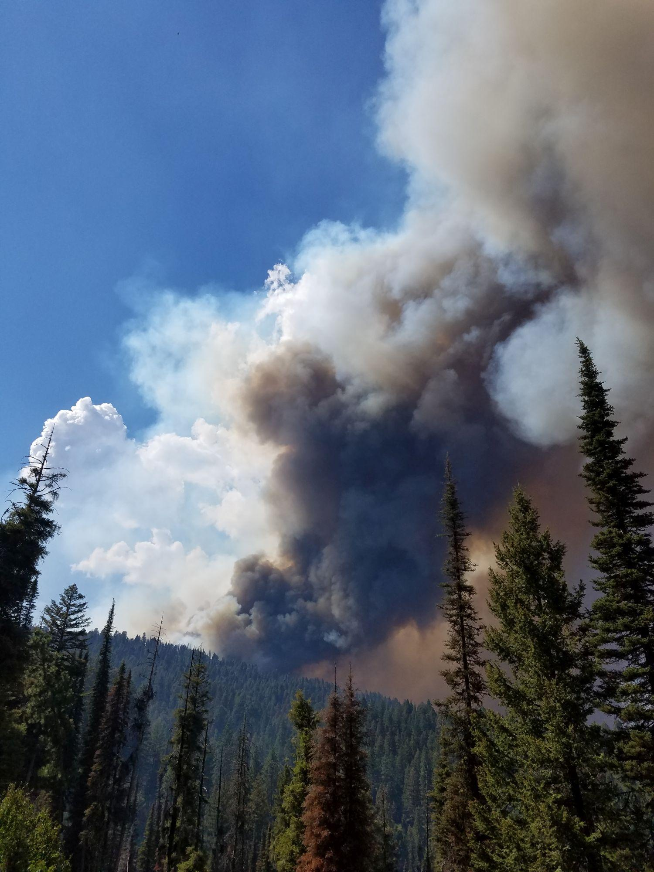
Introduction to Fire Assessment
You will learn:
What a fire assessment is.
When a fire assessment is done.
Why a fire assessment is done.
Who performs a fire assessment.
A Fire Assessment versus An Initial Fire Report (IFR).
Who receives a fire assessment.

Slide 5
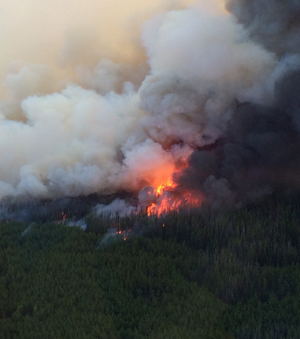
Wildfires in British Columbia
Over the past 10 years:
There have been 2000 wildfires per year.
Burn close to 115000 hectares (ha).
61 % caused by lightning.
39 % are human caused.

Slide 6
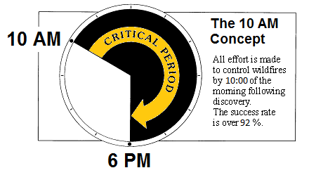
The 10 AM Concept

Slide 7
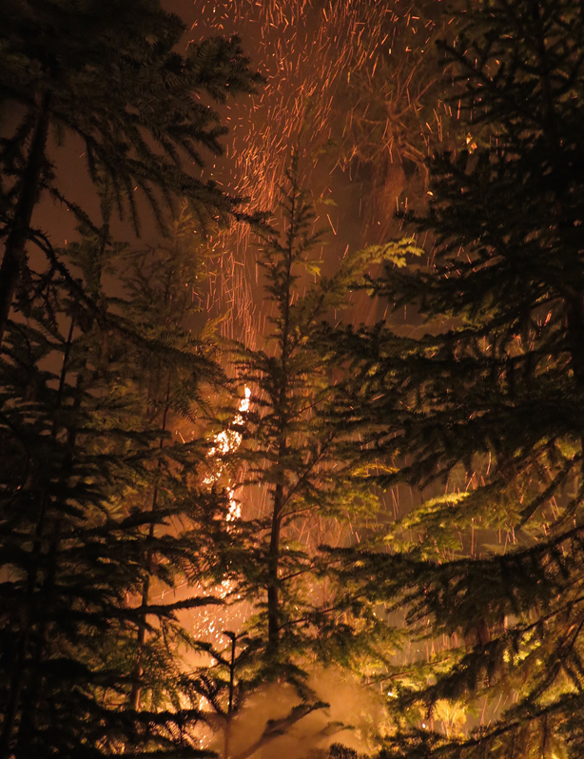
Importance of Assessment
Wildfires need to be reported to BCWS staff promptly.
A Fire Centre will send resources to wildfires.
Reporting and an accurate fire assessment are critical to the 10 AM Concept.

Slide 8
What is Fire Assessment?
Fire assessment is an ongoing process that includes:
All values at risk.
Present and expected fire behaviour.
Fuels, weather and topography.
Fire potential and best plan for suppression.
Resources required for suppression.
Fire hazards and crew safety issues.

Slide 9
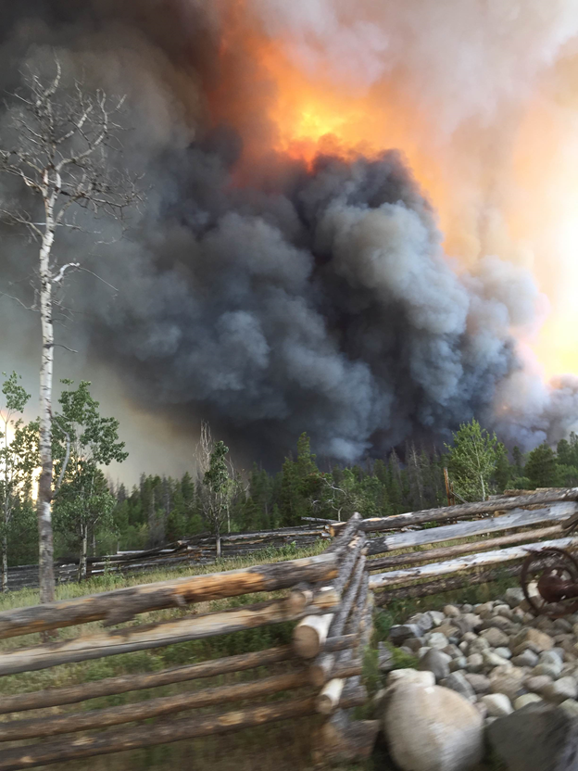
When are Fire Assessments Done?
Upon arrival at a fire.
For any changes in fire behaviour or weather conditions.
When a set update is required.
When a supervisor needs to know the suppression progress.
Increase in Fire Behaviour

Slide 10
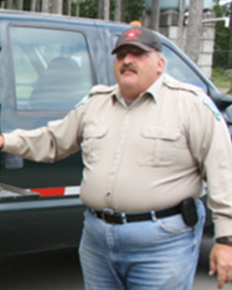
Who Receives Fire Assessment Information?
Regional Wildfire Coordination Officers (RWCOs).
Zone Wildfire Coordination Officers (ZWCOs).
All wildfire personnel working on suppression.
The
ZWCO

Slide 11
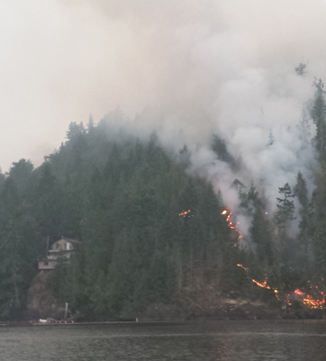
Why are Fire Assessments Done?
Fire Assessments are completed in order to:
Update the Fire Zone and Fire Centre.
Provide resource requests.
Establish priorities when there are multiple fires.
Allocate resources effectively.
Cabin
at Risk

Slide 12
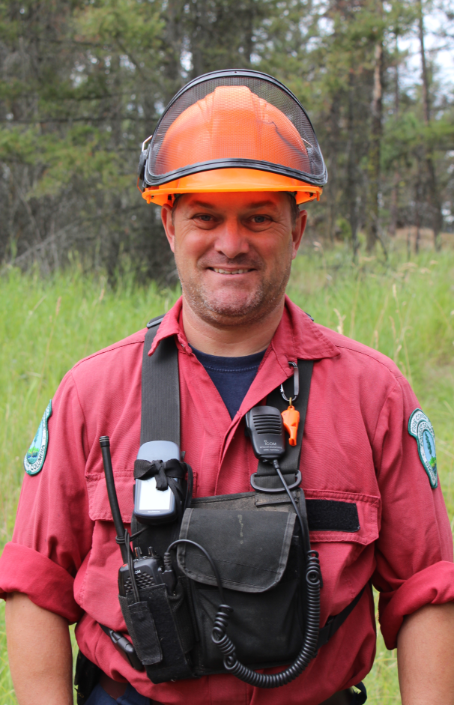
Who Performs Fire Assessments?
Initial Attack Crew Leaders.
Incident Commanders.
Air Patrol Officers.
Experienced Firefighters.
The quality of the assessment depends on fire experience.

Slide 13
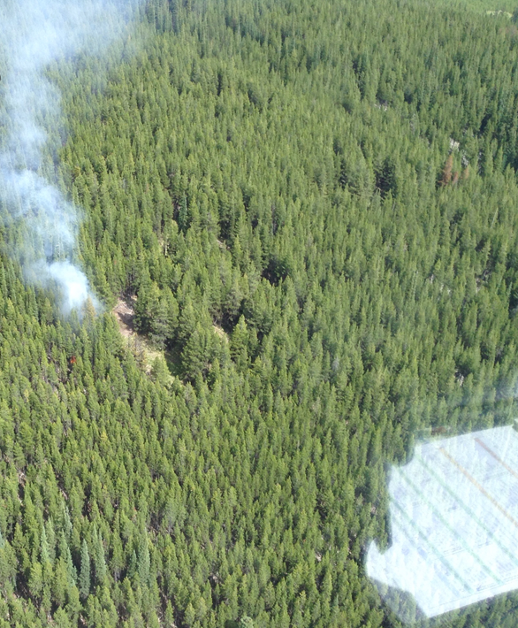
A Fire Assessment vs. An Initial Fire Report
An IFR is done only once for a fire.
An IFR is the start of a fire assessment.
Fire assessments are continuous.
Assessments provide continuous information to the Fire Centre.
IFR Pad

Slide 14
Roles and Responsibilities

Slide 15
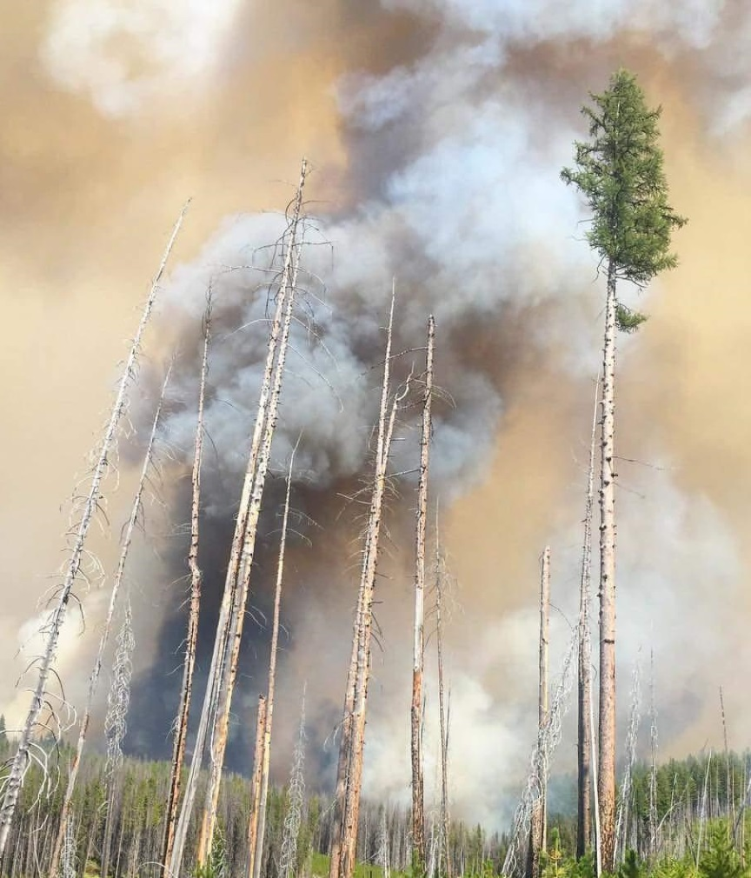
The Assessor and Duty Officers
Fire Assessment:
  IC and IA Crew Leaders.
  Experienced Firefighters.
The RWCO and ZWCO:
  Duty Officers.
A Flare Up

Slide 16
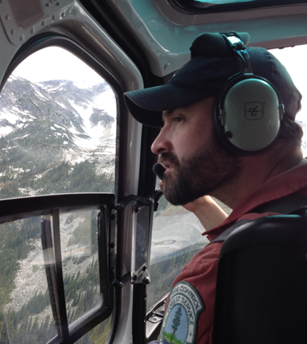
Experienced Firefighters
An IC may request an assessment by experienced personnel if:
A flare up occurs.
There are control difficulties.
There are values at risk.
There is a new wildfire in the area.
Assessment By Helicopter

Slide 17
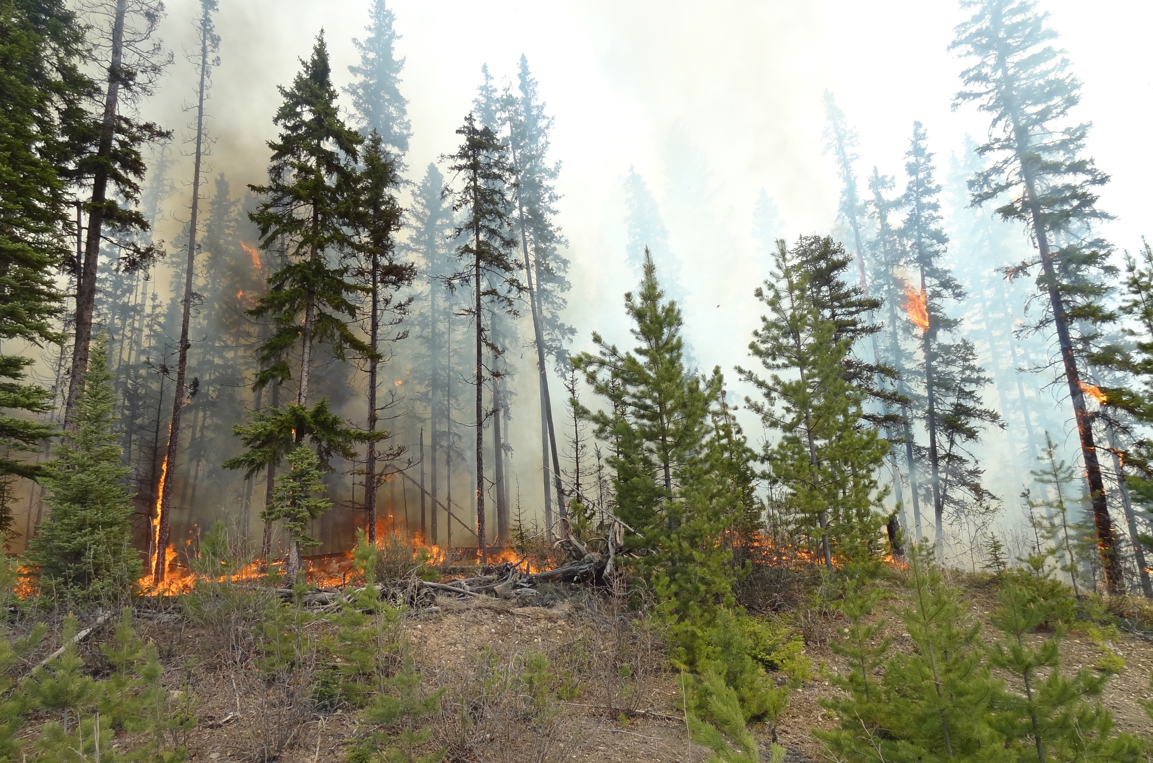
Responsibilities While Completing an Assessment
Be Prepared and Organized.
Be Thorough - perform a complete and on going reconnaissance (Recce).
Be Accurate - record all fire information.
Communicate - the fire information effectively.

Slide 18
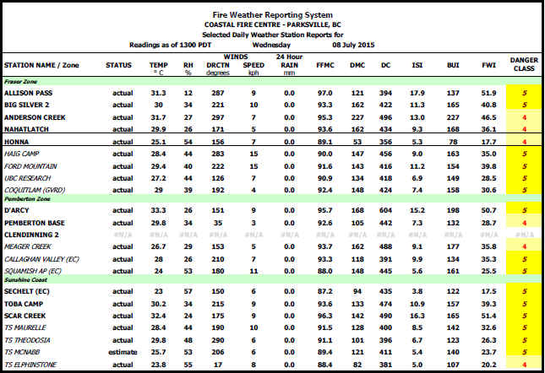
Before Arrival at the Fire
Obtain updated information about the fire behaviour.
Look at weather forecasts.
Travel using the route that gives the best vantage point.

Slide 19
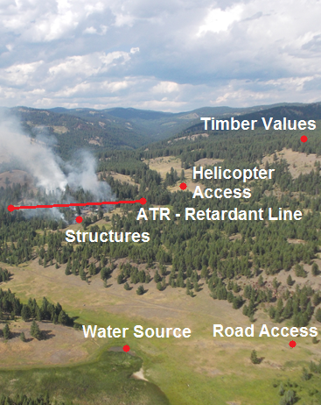
Upon Arrival at the Fire
Identify LACES and fire hazards.
Estimate the potential for fire growth.
Determine whether more resources are needed.
Establish priorities considering values at risk.

Slide 20
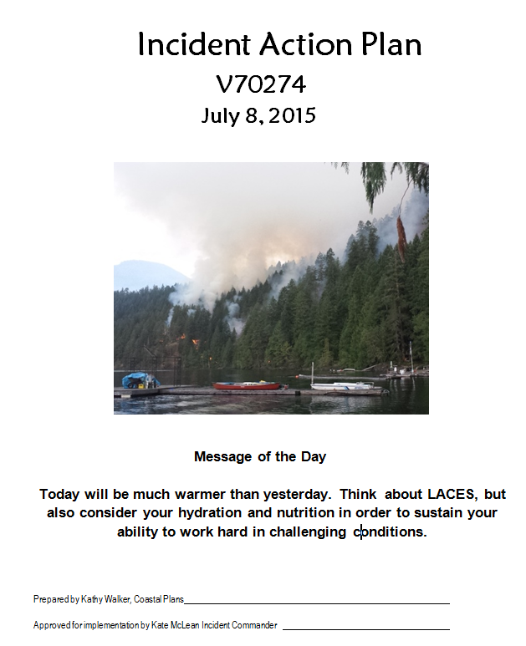
After Initial Fire Size-Up
Start an informal Incident Action Plan:
  Objectives, Strategies and Tactics.
Investigate the fire cause.
Preserve the ignition point.
Keep the Duty Officers informed.

Slide 21
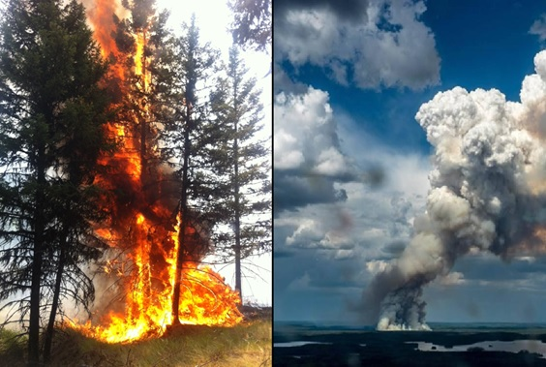
Ongoing Fire Updates
Continuously re-assess the fire.
Adjust strategies and tactics as needed.
Request more resources if required.
Communicate hazards.
Ensure that fire suppression follows safety protocols.

Slide 22
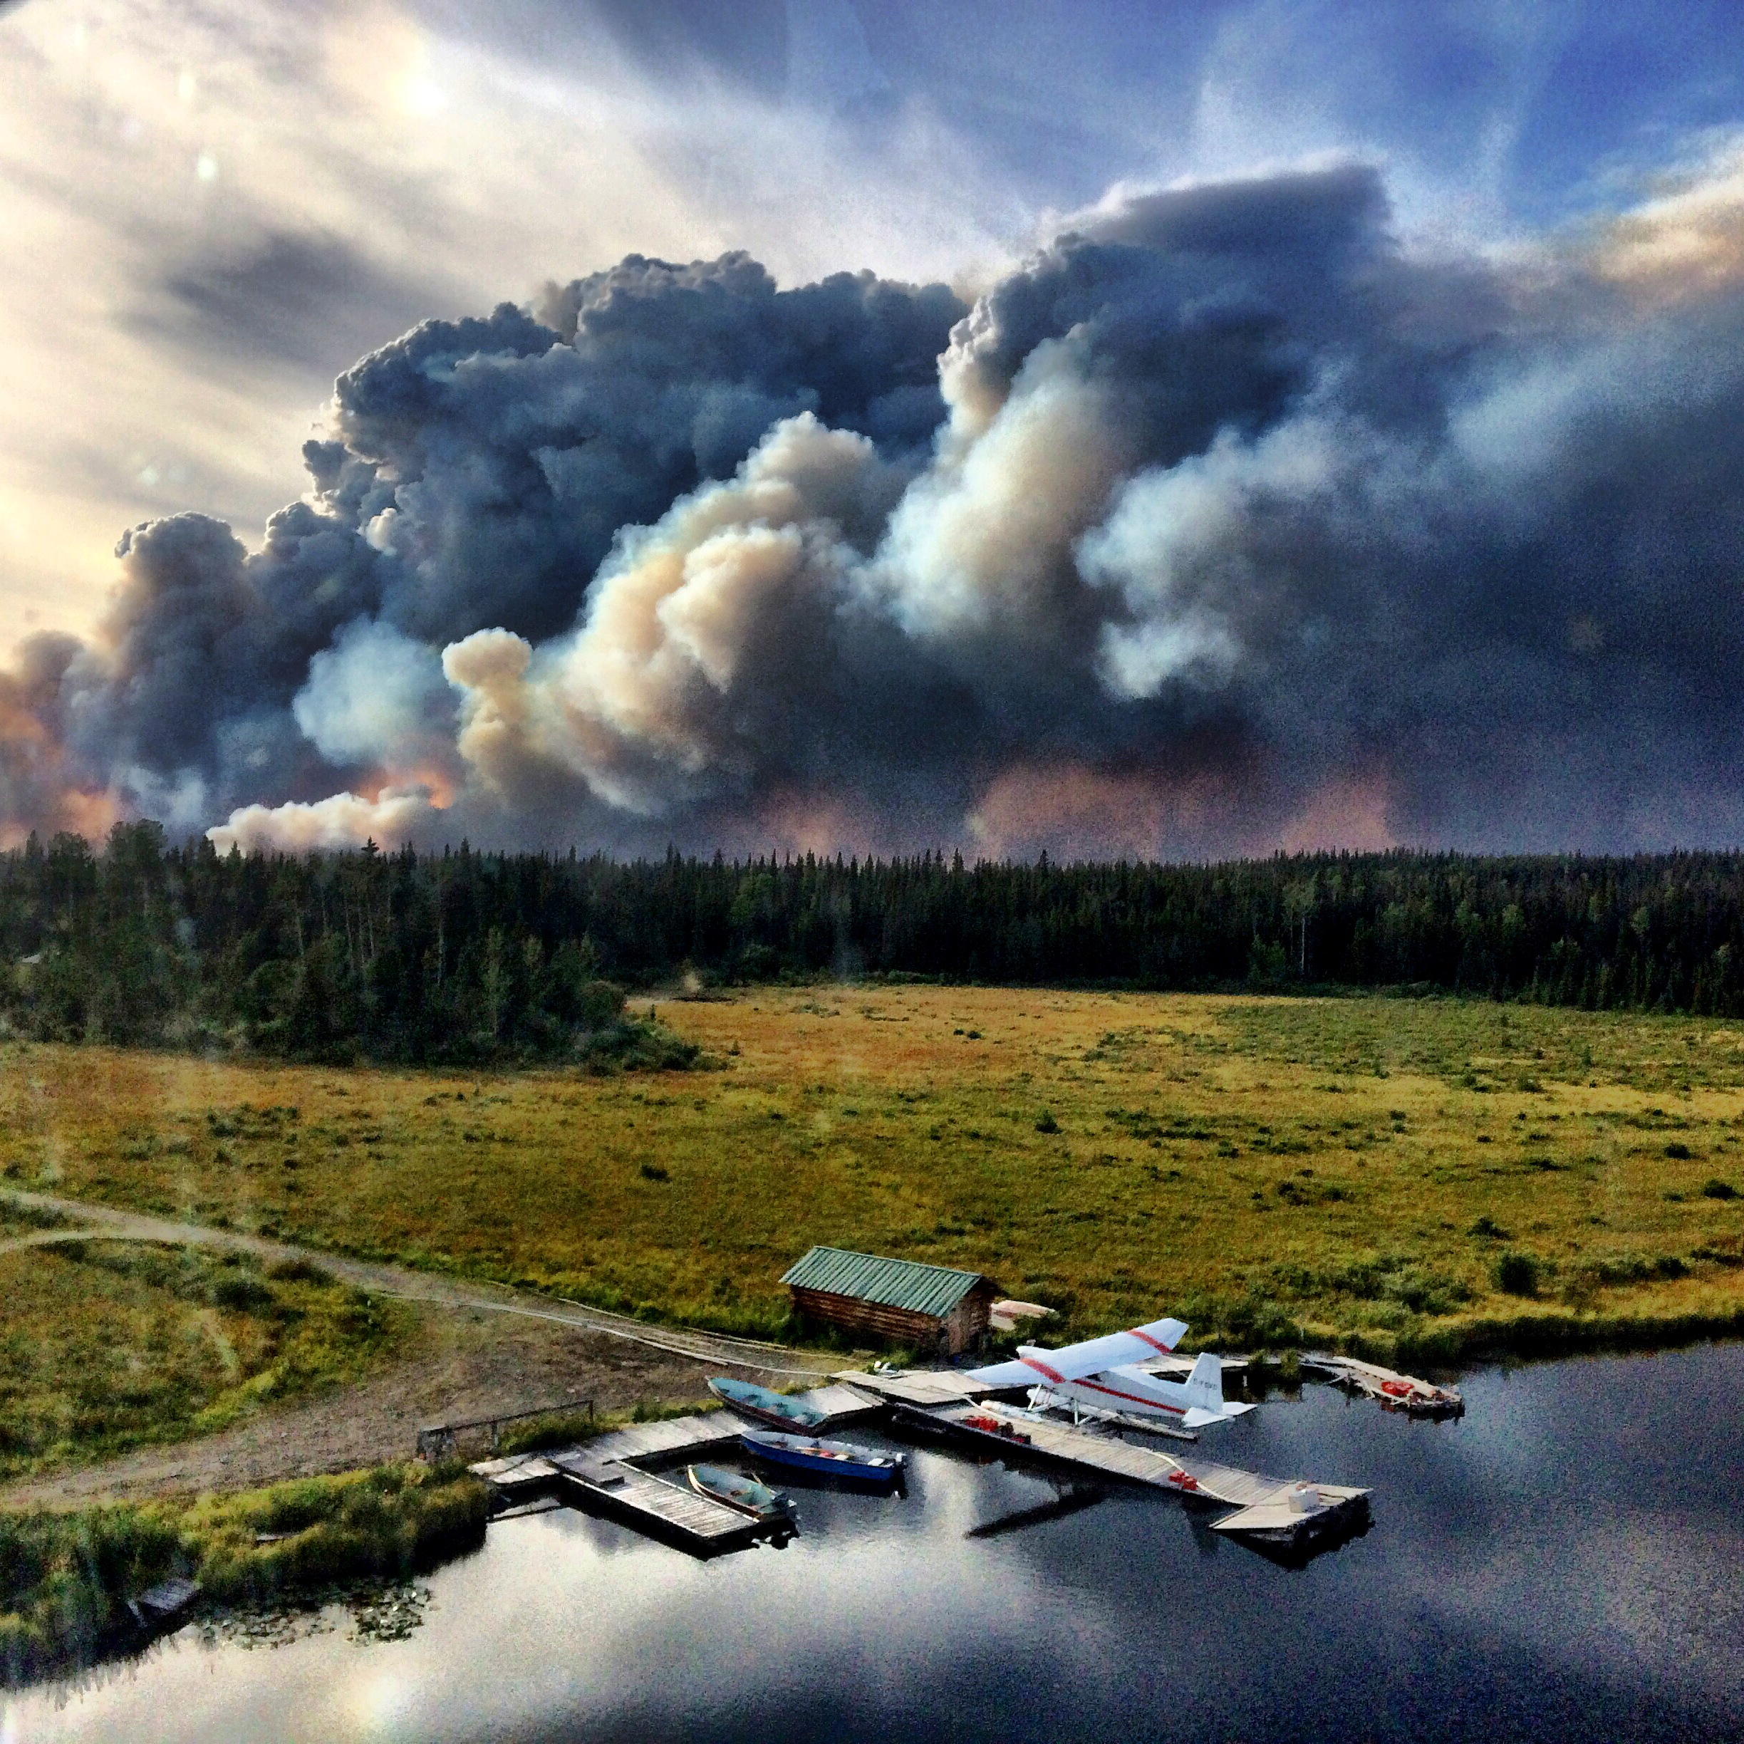
Responsibilities of the Duty Officers
To compile all information about fires.
  from the IFRs and fire assessments.
To mentor less experienced fire personnel through the assessment process.
To deploy the resources necessary to meet suppression objectives.
To request additional support from the PWCC.

Slide 23
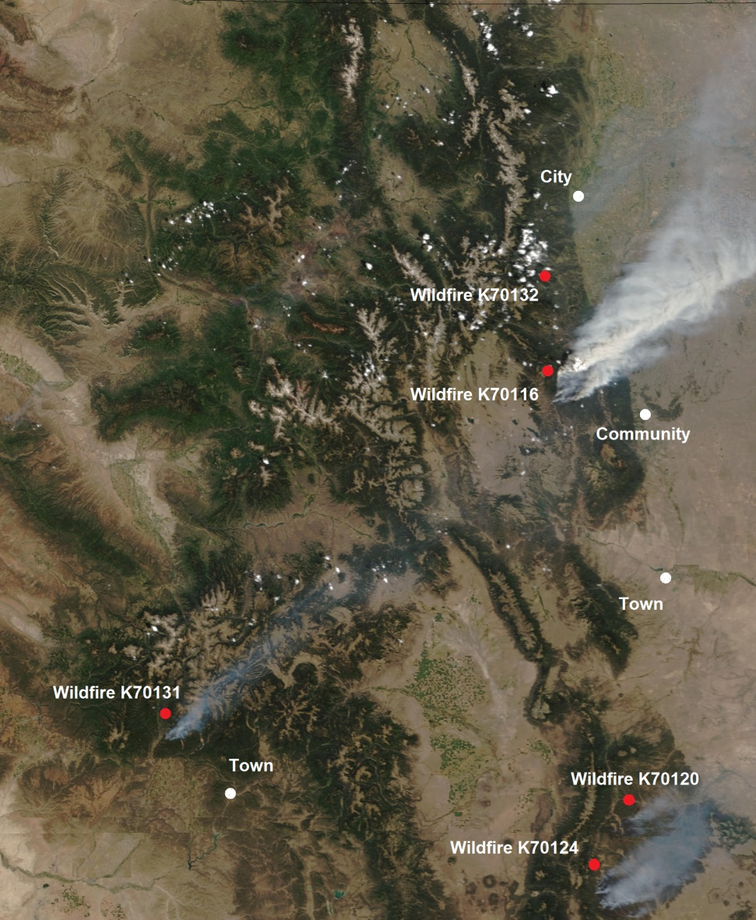
Multiple Fire Situations
The RWCO will determine wildfire suppression priorities after considering:
Values at risk.
Concerns identified by the Fire Zones.
All relevant wildfire information.
Where resources will be most effective.

Slide 24
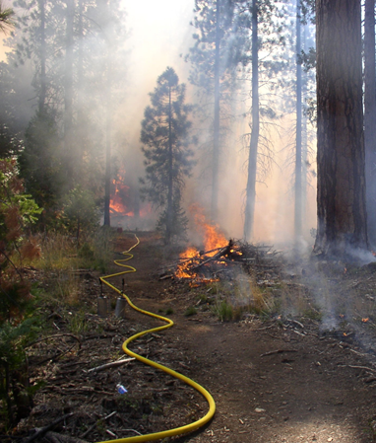
When the Control Objectives Are Not Met
The Duty Officers will decide:
to Continue Fire Suppression.
  IC will run fire operations.
  Fire Centre will support.
to Stop Fire Suppression.
  If not in fire management plan or too dangerous.
  Wait for fire analysis.
A Tactical Withdrawal

Slide 25
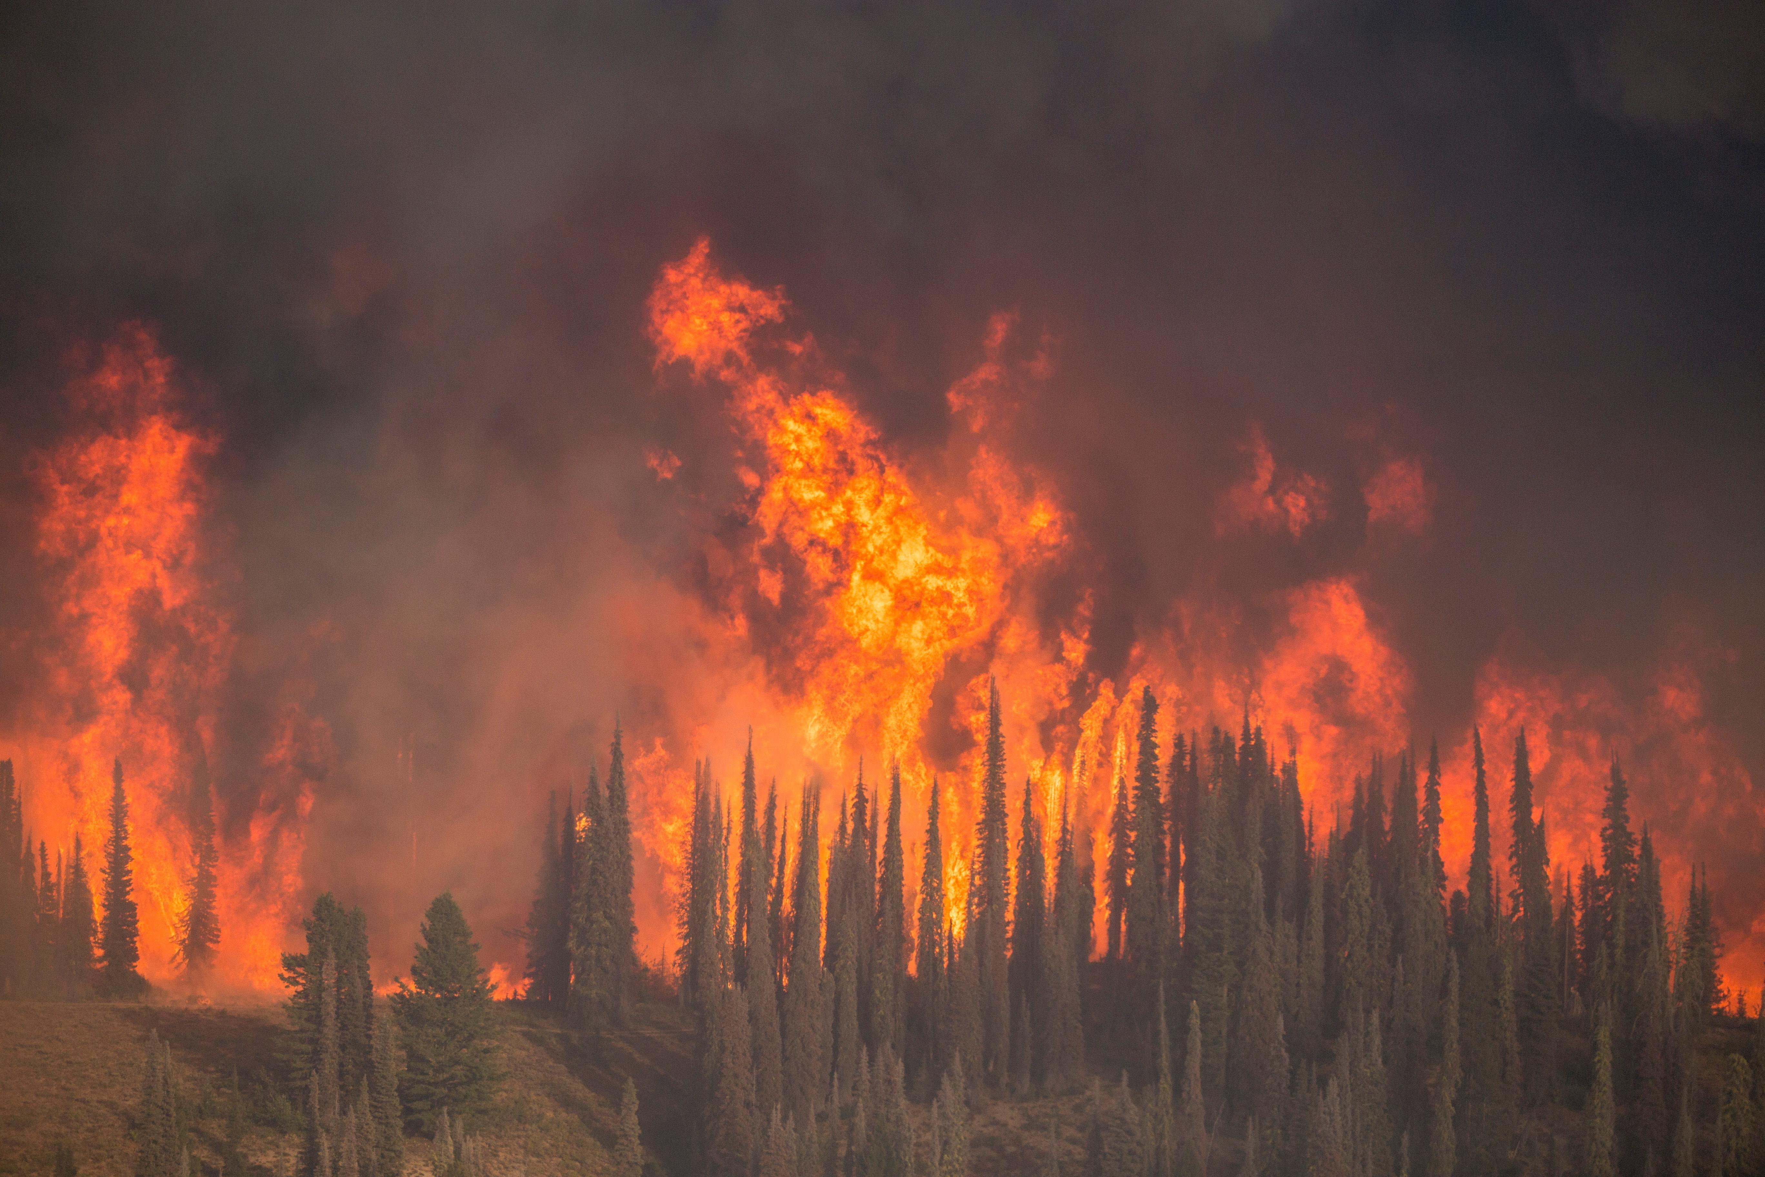
Stopping Fire Suppression
Generally based on safety concerns.
Fire could be put into modified response.
The fire will be monitored.
Possible containment lines should be determined.
Trigger points for fire suppression are established.

Slide 26
Your Role and Responsibilities
If you are completing a fire assessment:
Be aware of the weather and fire behaviour forecasts.
Be prepared for the assessment tasks.
Consider the assessment when determining objectives.
Keep crews safe with continuous updates - Lookouts.

Slide 27
Fire Behaviour

Slide 28
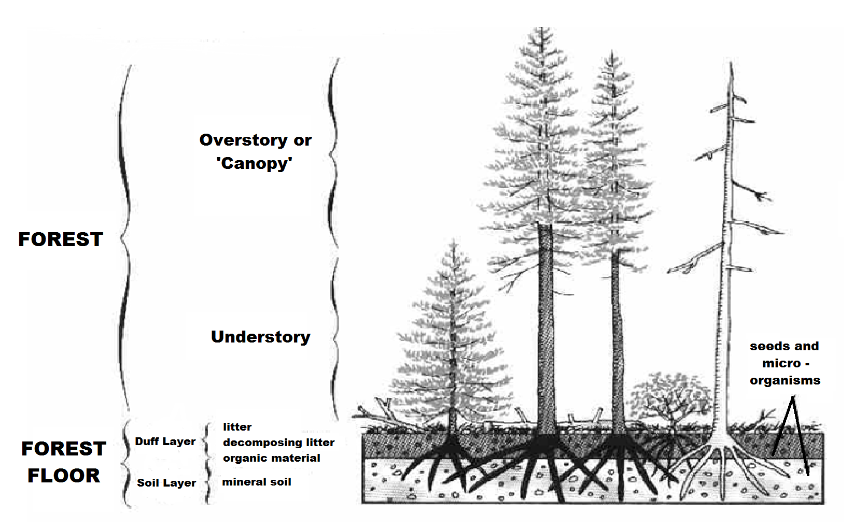
Forest Layers

Slide 29
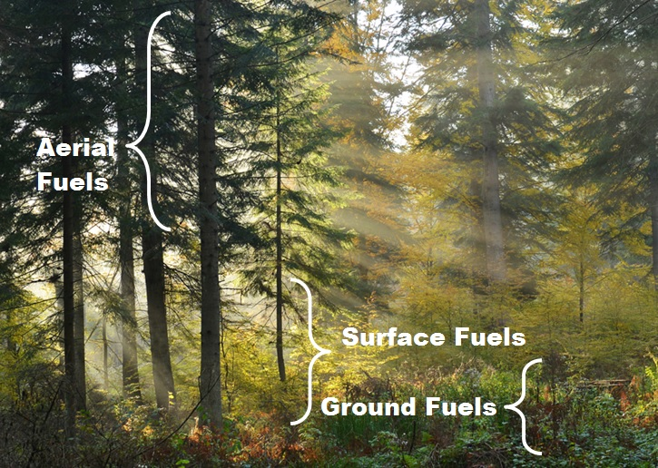
Forest Fuels

Slide 30
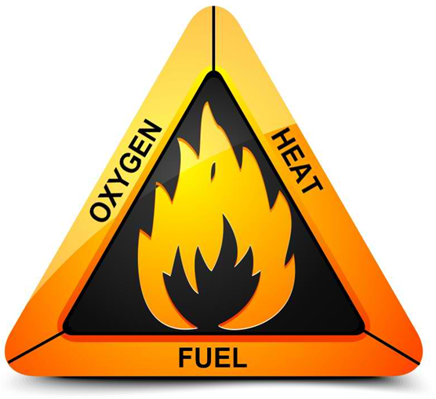
The Fire Triangle

Slide 31
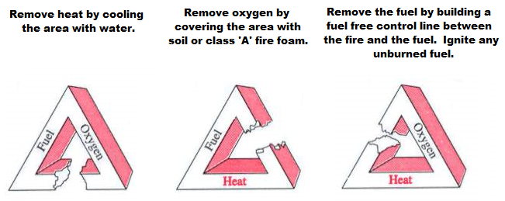
Suppressing Wildfires

Slide 32
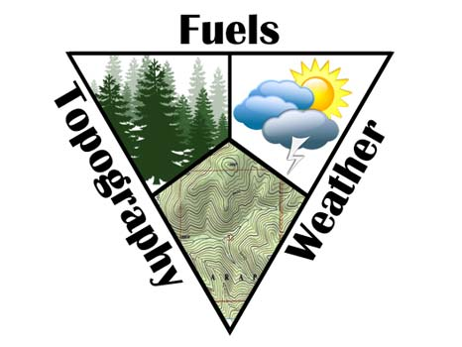
Fire Behaviour Factors

Slide 33
Factors Influencing Fire Behaviour
Fuel
Moisture
Size
Spacing
Load
Weather
Wind
Temperature
Relative Humidity (RH)
Precipitation
Topography
Slope
Aspect
Terrain
Elevation

Slide 34
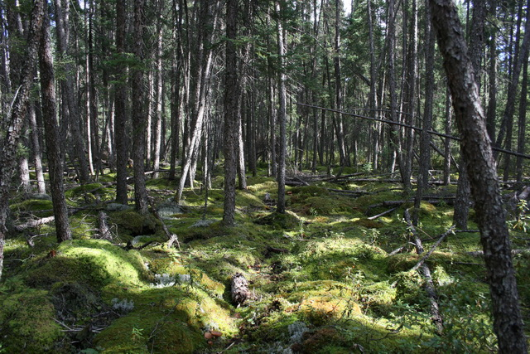
Fuel
Moisture - refers to the water content within forest vegetation.
  Most critical fuel factor.
  Dead and dry fuels ignite more readily.
Size - heavy, slow burning or light, fast burning.
Spacing - Horizontal and Vertical fuels.
Loading - accumulation or mass of fuels in a given area (tons/hectare).

Slide 35
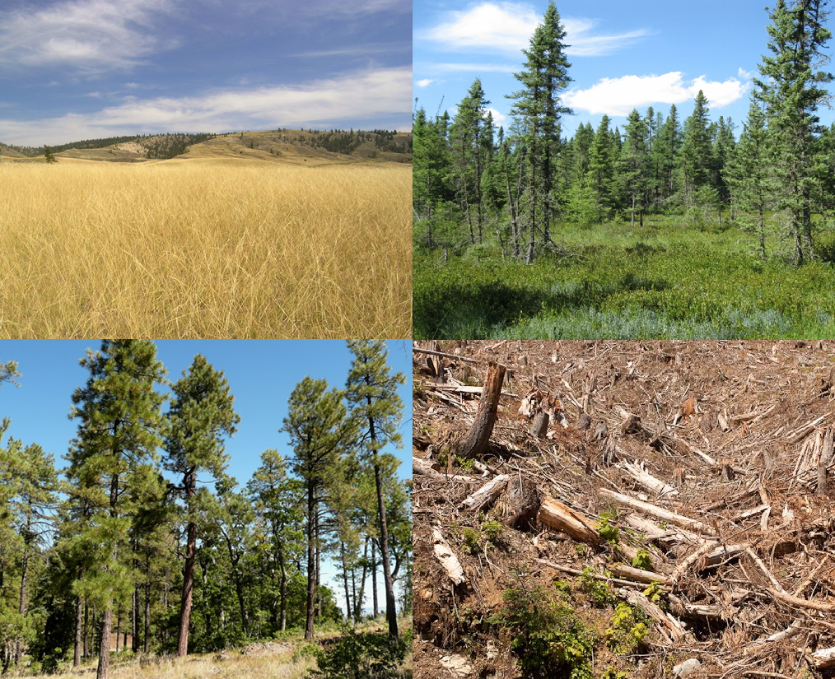
Sample Fuel Types

Slide 36
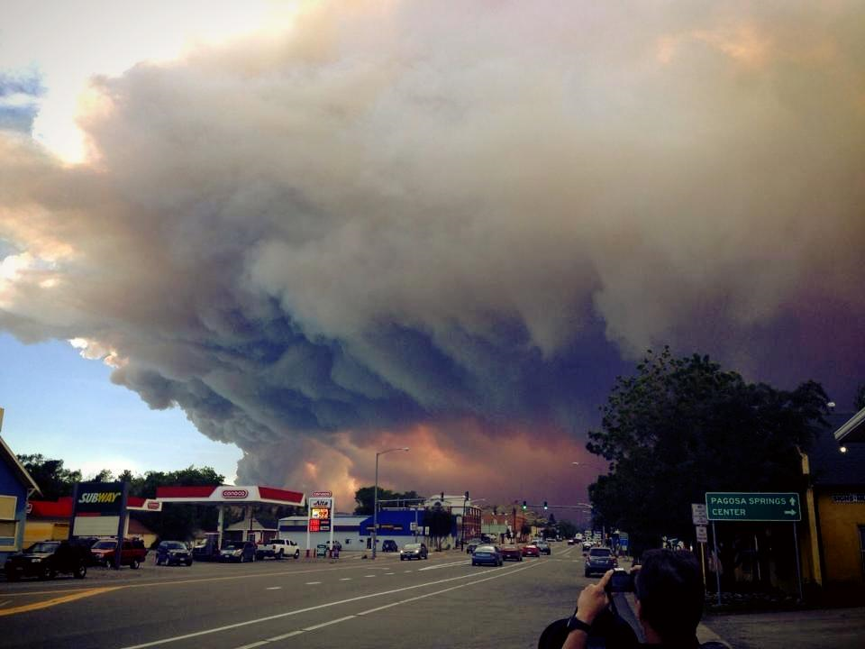
Weather
Wind - pushes wildfires into new fuels.
  Most critical weather factor.
  Dries out fuels and causes spotting.
Precipitation - rain increases fuel moisture content.
Relative Humidity (RH) - the percent of water vapour in the air.
Temperature - preheats fuels and decreases the RH.
Erratic wind will cause severe fire behaviour.

Slide 37
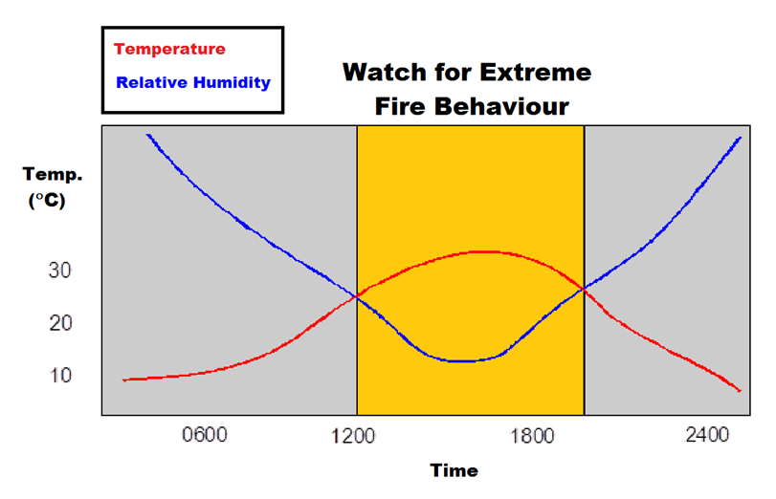
The 30/30 Crossover Concept

Slide 38
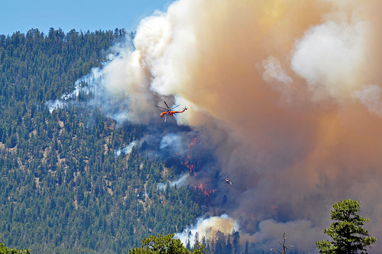
Topography
Slope - fire spreads rapidly on steep slopes.
  Most critical topography factor.
  Upslope fuels are closer to flames.
Aspect - South facing slopes get more direct sunlight.
Terrain - many natural features will funnel wildfires.
Elevation - warm air is trapped at low levels.
Steep, South facing slopes will have increased fire behaviour.

Slide 39
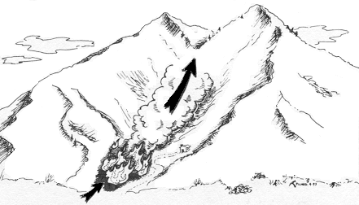
‘Chimney Effect’
Gullies, Valleys and Canyons

Slide 40
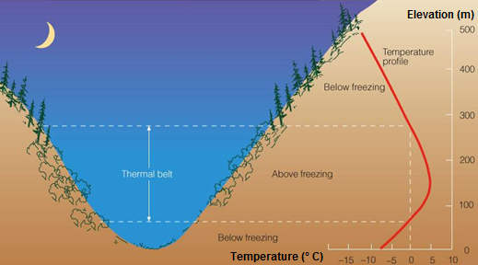
Thermal Belts

Slide 41
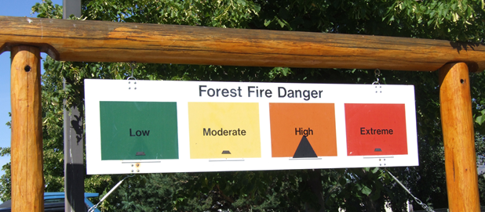
The Canadian Forest Fire Danger Rating System (CFFDRS)
This system is used to determine:
Potential fire behaviour.
Fire spread rates.

Slide 42
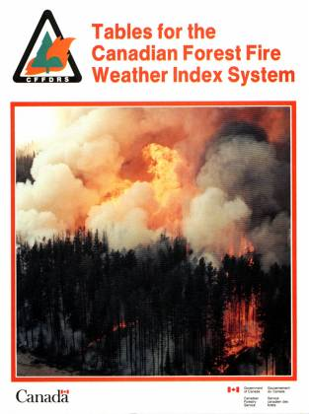
The CFFDRS
Is a standard national fire danger rating system.
Preparedness based on fire potential and fire spread rates.
2 sub-systems include:
  Fire Weather Index (FWI) System.
  Fire Behaviour Prediction (FBP) System.

Slide 43
Fuel Moisture Codes
There are 3 fuel moisture codes used in the FWI.
Code | Represents | Time Lag * | Amount of 24 hour rainfall required to lower value
FFMC: Fine Fuel Moisture Code | Surface litter | 2/3 day | 0.6 mm
DMC: Duff Moisture Code | 5 - 10 cm duff | 12 days | 1.5 mm
DC: Drought Code | 10 - 20 cm duff | 52 days | 2.9 mm
* Time lag refers to the time required for fuel to lose 2/3 of its moisture under standard drying conditions.

Slide 44
Fine Fuel Moisture Code
Litter, twigs, grass and other small cured fuels.
Affected by wind, temperature, rainfall and RH.
CODE / INDEX | INTERPRETATION
FFMC Less than 77 77 - 86 More than 86 Greater than 94 | Generally a fire will not start without a concerted effort. Approximately 50 % of ignition sources will start fires. Easy ignition of forest fuels. Almost 100 % of ignition sources will ignite forest fuels.

Slide 45
Duff Moisture Code
Duff layer is 5 - 10 cm deep.
Includes medium sized woody material.
Affected by rainfall, temperature and RH.
CODE / INDEX | INTERPRETATION
DMC Less than 35 | Do not expect a great deal of involvement of fire in this layer. Expect more intense fires if above this level.

Slide 46
Drought Code
Deep duff layer is 10 - 20 cm deep.
Includes roots and logs.
Affected by rainfall and temperature.
Seasonal drought increases DC substantially.
CODE / INDEX | INTERPRETATION
DC 0 - 300 300 - 450 500 + | Very little involvement of this fuel on most fires. Increased involvement with fires becoming more intense and mop-up problems increasing. Extensive involvement of the fuel layer. Fires are intense with difficult mop-up problems due to the depth of the fires.

Slide 47
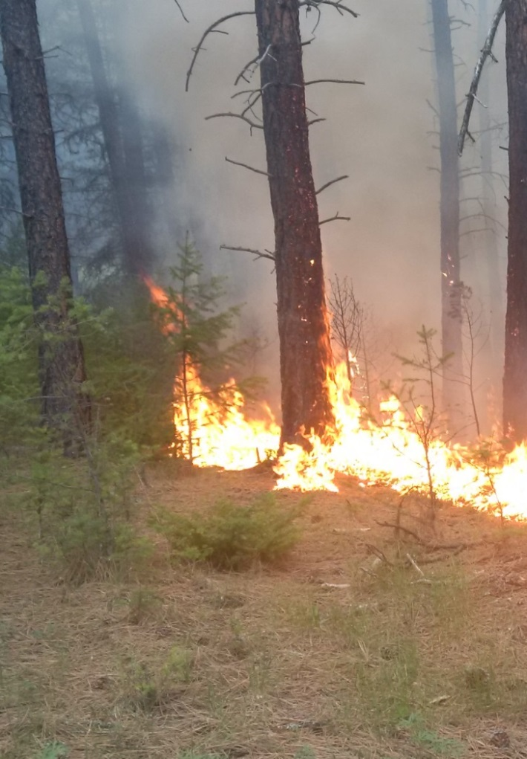
Fire Behaviour Indices
ISI: Initial Spread Index
  The fire spread rate immediately after ignition.
BUI: Build Up Index
  The amount of fuel available for consumption.
FWI: Fire Weather Index
  Potential fire intensity.
  Fire danger levels.
Fire
Spreading . . .

Slide 48
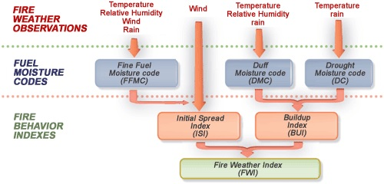
The Fire Weather Index (FWI)

Slide 49
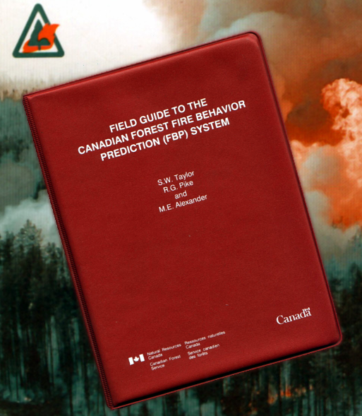
The Red Book
All values are input into the FBP Red Book.
Fire behaviour can be predicted using the outputs.

Slide 50
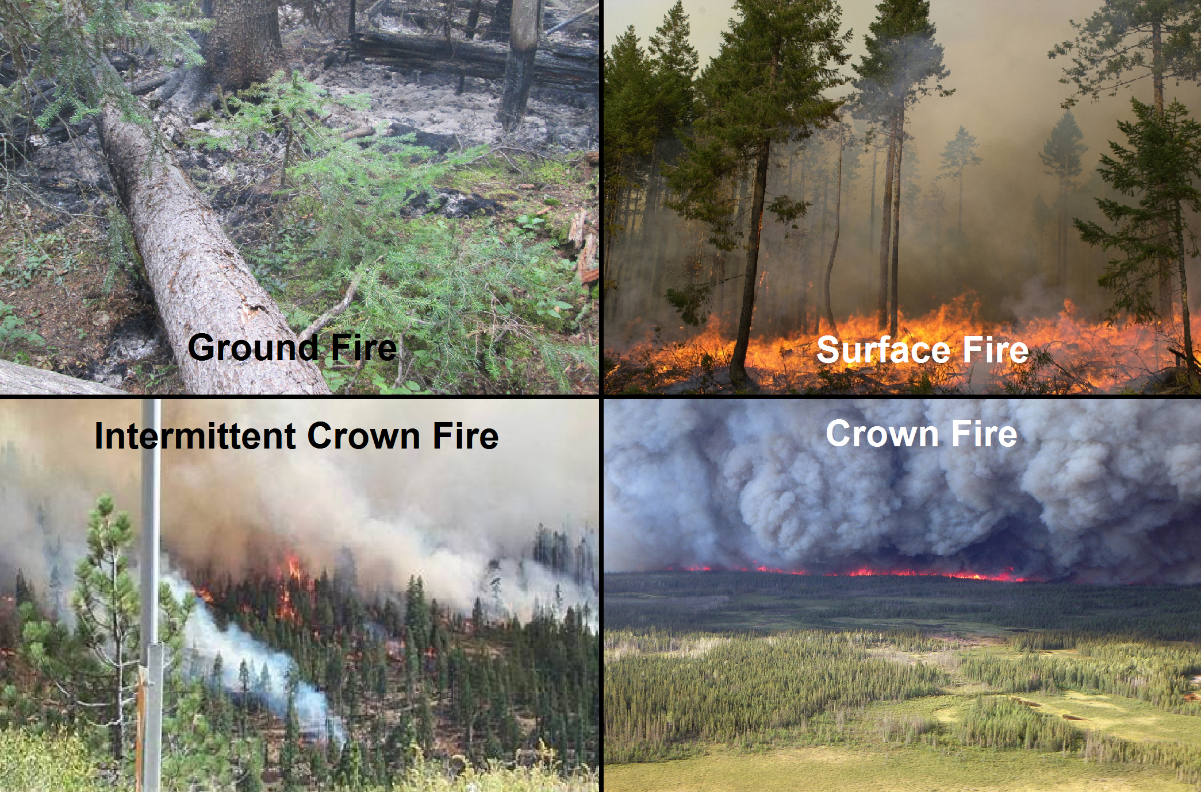
Fire Types

Slide 51
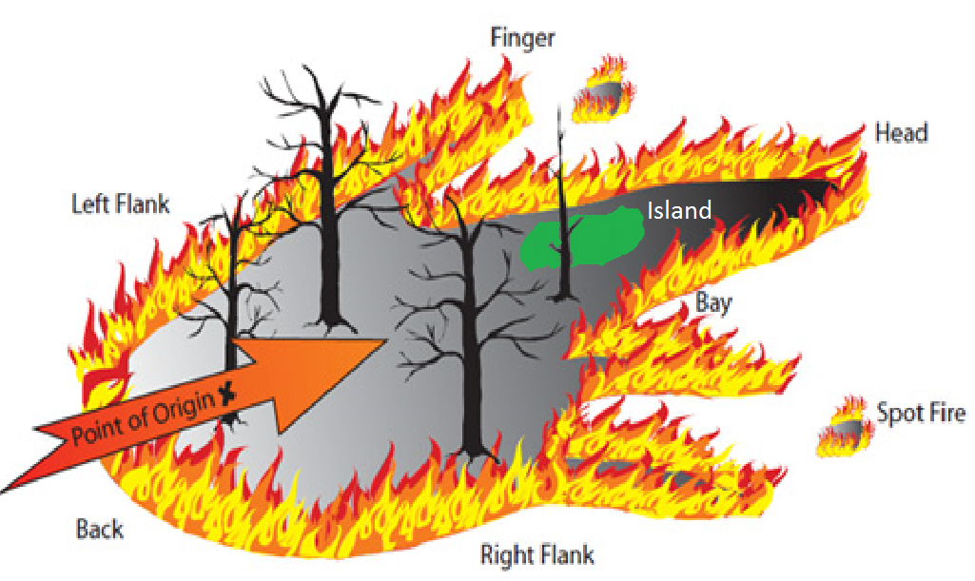
Parts of a Fire
Head
Back/Heel
Flank
Finger
Bay
Island

Slide 52
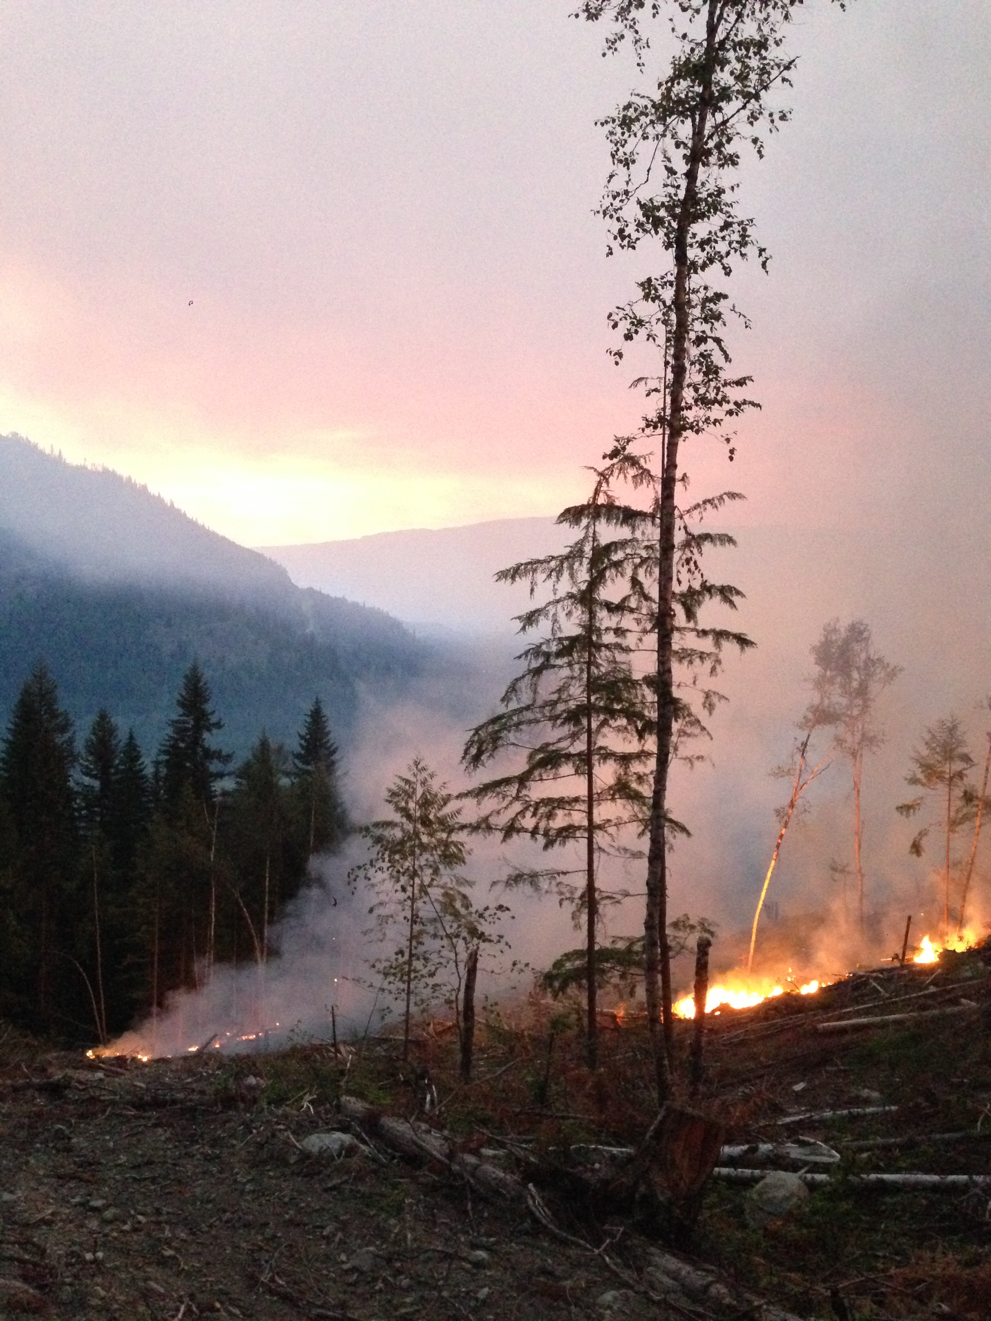
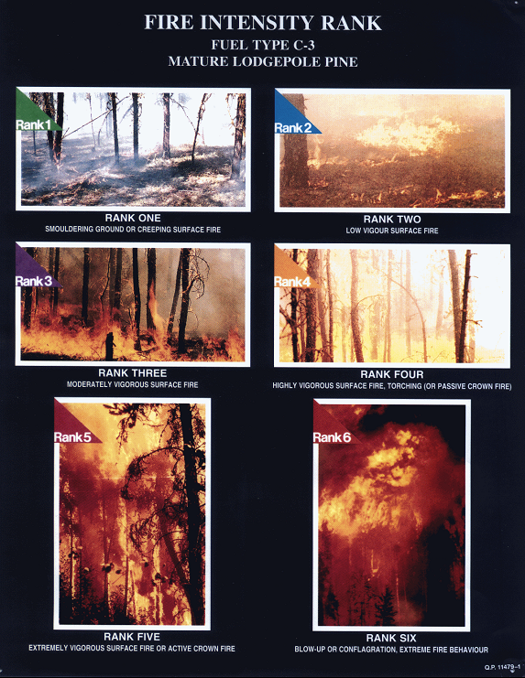
Fire Intensity Rank

Slide 53
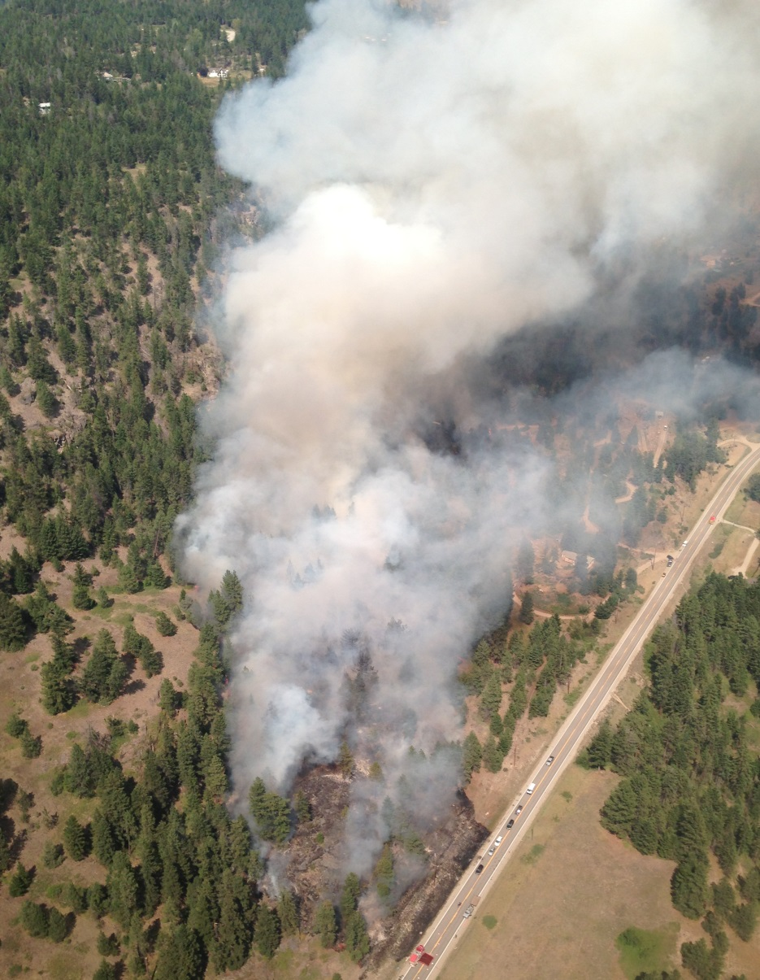
What You Need to Know for Fire Assessments
Hazards of intense fire behaviour.
The 3 factors influencing fire behaviour.
Fuel moisture, wind and slope issues.
The 4 Fire Types.
The 6 Fire Intensity Rankings.

Slide 54
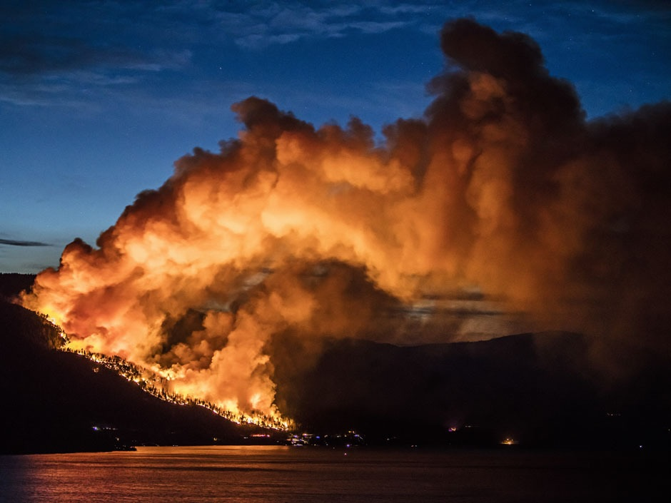
Questions?

Slide 55
Preparing for a Fire Assessment

Slide 56
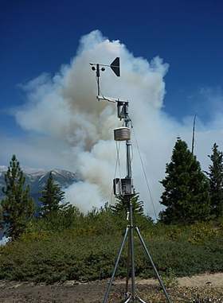
Daily Preparation Requirements
Determine current fire behaviour in the zone.
Examine weather forecasts.
Know current resource availability.
Have the equipment and materials for fire assessment ready.
Portable Weather Station

Slide 57
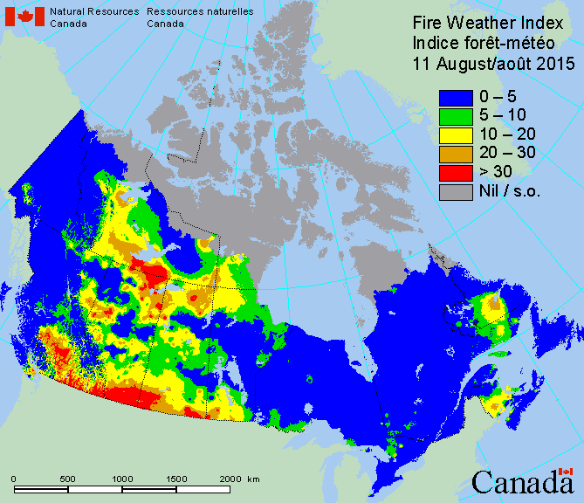
Daily Fire Weather and Fire Behaviour Forecasts
Temperature, RH and Wind Speed are key.
Weather stations provide FWI at 13:00.
Use the nearest weather stations.
Track cold fronts and thunderstorms.
Ask for fire behaviour advisories.

Slide 58
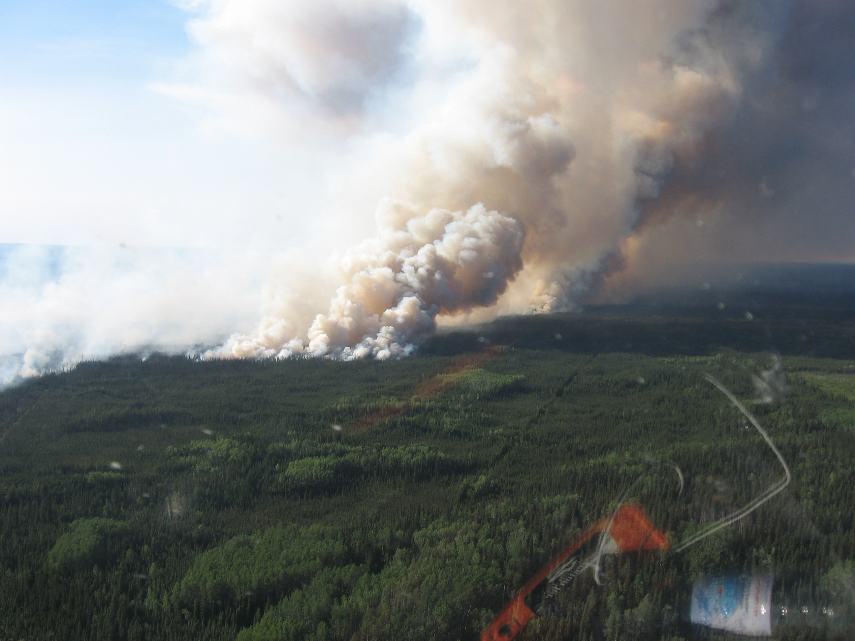
Current Fire Behaviour in the Area
Ask about the fire behaviour on local wildfires.
Discuss suppression difficulties on these fires.
Monitor the radio for changes in fire activity.
Talk to firefighters already in the field.

Slide 59
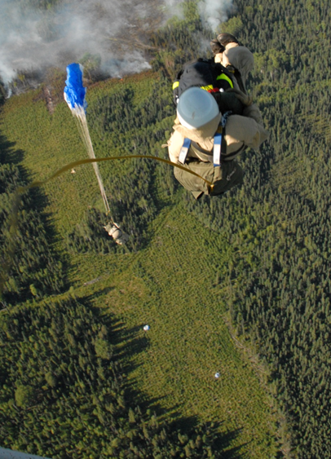
Resources Available and Capabilities
Helicopters.
Air Tankers.
Heavy Equipment.
Specialty Crews - Para Attack and Rappel.
Sustained Action Crews.
Water Tankers and Tenders.
Para Jumping Wildfire

Slide 60
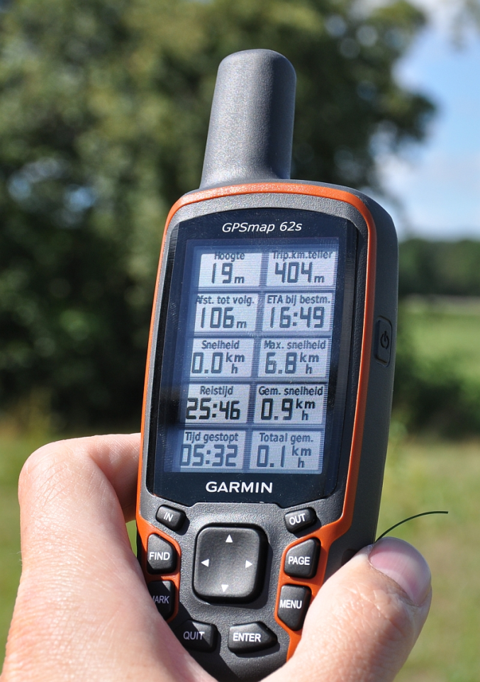
Equipment and Materials Required
Maps of the Fire Zone and access routes.
Pens, pencils and ruler.
Clipboard with paper.
Ticker or flagging tape.
A handheld GPS unit.
An IFR pad (FS 260).
A weather kit.

Slide 61
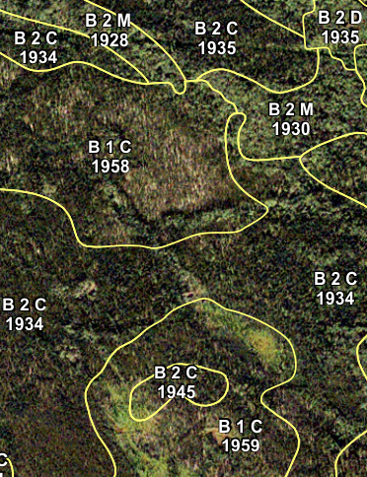
Helpful Fire Assessment Tools
CFFDRS FBP System Field Guide or Red Book.
Digital camera with extra batteries and memory card.
A completed IFR.
Vegetation Resource Inventory (VRI) maps of the fire area.

Slide 62
On Route to the Fire
Examine any topographic or vegetation maps of the area.
Become as familiar with this location as possible.
Start any paperwork necessary - including the IFR.
Review the weather forecasts.
Predict the expected fire behaviour.
Watch for public in the area - potential cause.

Slide 63

Questions?

Slide 64
Conducting the Fire Assessment

Slide 65
Conducting the Fire Assessment Topics
This section will explain the following:
General consideration when conducting a fire assessment.
Initial communications to the Fire Centre.
Transmitting the IFR to Dispatch.
How to do fire reconnaissance (‘Recce’).
Completing the Initial Fire Report.
The Fire Assessment.

Slide 66

General Considerations
Remain calm.
Check your location - on the right fire.
Use common sense during the Size Up.
Use Adaptive Management - re-evaluate the situation.
Do not avoid decisions.
Communicate - the fire assessment information to the Fire Centre and crews.

Slide 67

Initial Communications
Immediately notify the Fire Centre Dispatch once on site.
Provide a rough geographic location.
Do not wait until the IFR is complete.
Provide a basic fire assessment if possible (smoke and terrain).

Slide 68

Sample Radio Transmission
“Prince George Fire Centre. Prince George Fire Centre. This is NIFAC 72 Alpha with a fire report. Are you ready to copy?”
Wait for response and then continue...
“I have located a small (or large), fast (or slow) moving wildfire 1 kilometer north of Gwillim Lake, approximately 300 meters west of a Forest Service Road. It is putting off white smoke.”
“Please standby for an IFR and fire assessment.”

Slide 69

Fire Reconnaissance or ‘Recce’
Will be completed upon arrival at a wildfire.
Can be done from the air or by ground on approach.
Observe the fire activity and fuels.
Observe the surrounding environment.

Slide 70

Recce from an Aircraft
Brief the pilot about assessment objectives.
The assessor must have best view of the fire.
Observations need to be noted - written.
Take photos or direct a crew member to if possible.

Slide 71

Completing Aerial Observations
1st Pass - High:
At altitudes of 1000 to 2500 feet.
Try to observe the whole fire.
2nd Pass - Low:
At 150 to 300 feet - avoid fanning fire with rotor wash.
Identify specific factors about the area.

Slide 72

Low Level Observations
Note the following when completing a Recce:
Details about fuel types and topography.
Helicopter and vehicle access points.
Nearby water sources.
Description of any vehicles in the area.

Slide 73

Recce from a Vehicle
Stop the vehicle at a good vantage point.
Observe the fire characteristics.
Determine the fire activity and terrain features.
Note any water sources on route.
Maintain a view on approach if possible.

Slide 74

The Initial Fire Report (IFR)
First document completed for a wildfire.
Communicated to the Fire Centre.
Divided using the phonetic alphabet.
  Makes for easier communication.
Crew Leaders can copy IFR from Dispatch.
  If not 1st on scene.

Slide 75



Slide 76

To Start an IFR
Name, Date and Time.
Geographic Location - a brief description.
Coordinates - Lat. and Long.
Elevation.
Ask the Fire Centre for an Incident Number.

Slide 77
Alpha - Size
1. Single Tree
2. Spot m x m Less than 10 m by 10 m
3. 0.1 - 0.2 or the size of an IA truck.
4. 0.3 - 0.5 0.5 ha = 100 m x 50 m
5. 0.6 - 1.0 1.0 ha = 100 m x 100 m
6. 1.1 - 2.0 2.0 ha = 100 m x 200 m
7. 2.1 - 4.0
8. 4.1 - 8.0 5.0 ha = 200 m x 250 m
9. Other ha

Slide 78
Size and Distance Estimation
Linear Comparison
Use a map to check the length of:
  a lake.
  a runway.
  the distance between 2 roads.
Compare this distance with the length of a fire flank.
Tree heights can be useful on smaller fires.

Slide 79
Size and Distance by Flight Time
To determine distance on the ground you must:
Have the pilot set up the aircraft to fly at a pre‑determined speed.
Time the aircraft as it flies between 2 points in the fire area.
Calculate the length of the flight path by:
  Converting the times, and multiplying the speed by the time.
  Multiplying to get the proper units (meters, kilometers).

Slide 80
Calculating Size
To calculate fire size you must:
Visualize the fire as a square, rectangle or triangle.
Fly along and measure the distance of 1 side (length) and 1 end (width) of the fire.
Measure the height and base for triangle shaped fires.

Slide 81


Fire Size by Flight Time

Slide 82
Sample Fire Size Calculations
Speed = 180 km/h
Flight time for length = 40 seconds
Flight time for width = 20 seconds
180 km/h = 50 m/sec x 40 seconds
= 2000 metres
180 km/h = 50 m/sec x 20 seconds
= 1000 metres

Slide 83
Sample Fire Size Calculations
Area of a 4‑sided object =
Length x Width
2000 m x 1000 m = 2000000 m²
2000000 m² ÷ 10000 m² = 200 ha
A single hectare is 10000 square metres (100 m x 100 m).

Slide 84
Bravo - Fire Rank
1. Rank 1, Smouldering Ground Fire
2. Rank 2, Open Flame, No Spread
3. Rank 3, Vigorous Surface Fire, Moderate Spread, May See Candling
4. Rank 4, Moderate to Fast Spread, Short Aerial Bursts, Spotting
5. Rank 5, Continuous Crown Fire, Spotting Distance m
6. Rank 6, Continuous Crown Fire, Blow-up

Slide 85
Charlie - Fuels
1. Grass
2. Brush
3. Deciduous
4. Slash
5. Reproduction
6. Open Timber
5. Heavy Timber
6. Other ____
7. FBP Type ____

Slide 86
Delta - Values at Risk (Immediately Threatened)
1. Life/Property ___________________
2. Timber (Forest) Resources (Including Reproduction) _
3. Other Special Values (Watersheds, Parks) ___
4. Distance ____ _ m N S E W of fire

Slide 87
Echo - Wind
1. Calm
2. Speed km/h
3. Direction N S E W
Calm Smoke is rising straight up.
1 to 15 km/h Smoke fans and bends slightly from a vertical to a horizontal.
16 to 30 km/h Smoke flows with the wind direction.
30 to 74 km/h Smoke flows parallel to ground and fire activity increases.
75 + km/h Wind storms pushing the fire in new directions and fire will be out of control.

Slide 88


Slide 89
Foxtrot - Adjacent Fuels
1. Grass
2. Brush
3. Deciduous
4. Slash
5. Reproduction
6. Open Timber
5. Heavy Timber
6. Other ____
7. FBP Type ____

Slide 90
Golf - Slope
1. Flat/Rolling
2. Moderate < 30 %
3. Steep > 30 % < 60 %
4. Extreme > 60 %
10 % slope ‑ 1 metre of vertically rise for every 10 metres of horizontal distance.
50 % slope ‑ 1 metre of vertical rise for every 2 metres of horizontal distance.
100 % slope - 1 metre of vertical rise for every 1 metre of horizontal distance.

Slide 91
Hotel - Aspect
1. North
2. South
3. East
4. West
South and southwest aspects get the most direct sunlight.
Have fine, flashy fuels
Fuels dry out rapidly.
These slopes have increased fire activity.

Slide 92
India - Slope Position
1. Bottom
2. Lower Third
3. Middle Third
4. Upper Third
5. Top
Position on a slope will indicate fuel type.
The position also dictates fire potential.
In addition, slope position serves as a location reference.

Slide 93
Juliet - Access
1. Road __ __ m
2. Heli-spot __ __ m
3. Hover Exit _ ___ m
4. Other __ __ m
5. N S E W of the fire
The distance and direction from the fire should be noted.
Natural or constructed openings make good heli-spots.
Large clearings can be used as ‘staging areas.’

Slide 94
Kilo - Available Water
1. None
2. Adjacent
3. ________ m N S E W of the fire
The availability of water and proximity to the fire will determine water delivery.
Indicate the source and potential supply issues.
Patches or a string of deciduous growth, tamarack or hemlock indicate a water source.

Slide 95
Lima - Paper Trailed and
Mike - Photos
1. Yes
2. No
All initial attack wildfires can be paper trailed.
Allows ground crews to find the fire with ease.
Photos are valuable for fire behaviour analysis and fire cause investigation.
Photos of the point of origin are key.

Slide 96
November - Suspected Fire Cause
1. Human
2. Lightning
Determining the cause of the fire is extremely important
Helps Fire Centre staff when billing for the incident.
If it is a human caused fire, the point of origin should be barricaded.

Slide 97

Actions Taken/Recommended
This section should not be overlooked.
Relay this information.
Describe resources committed and suppression progress.
Determine probability of success.

Slide 98

The Incident Number
From the Fire Centre.
Resources will be requested for this incident number.
The IFR will be filed under this number.
Serves as identification for all reports.

Slide 99
Communicating the IFR to the Fire Centre
Contact the Fire Centre by radio.
Wait until the dispatcher is ready.
Communicate the location and fire number.
Speak in a clear and concise manner.
Ask for the dispatch to repeat information.
Ask for feedback.

Slide 100

The Fire Assessment
Communicating What You See

Slide 101
Fire Assessment Checklist
Update the Fire Centre with relevant information.
Provide a summary of fire suppression activities:
  Firefighters and equipment on site.
  Control line locations and types.
  Resources required.
  Control problems (resistance to control).
  Anticipated time of control.
  Recommended action in the event of initial attack failure.

Slide 102

Fire Assessment Checklist
3. Safety Concerns
  Fire Hazards, Danger Areas , LACES, Check-Ins, etc.
4. Resource Request Considerations
  Determining the resources required to suppress a fire.
  Fundamental task of assessment.
  The following points need to be addressed:

Slide 103

Resource Request Considerations
Attempt to meet the control objectives:
  By the next day’s burning period.
  Assessments are key to decision making.
Anticipate fire behaviour.
  Be flexible with resources.
  Do not expect help.
Control Line
Needs

Slide 104
Resource Requirements
Make your resource requests complete.
  Consider all equipment and machines needed.
  Ensure resources arrive with appropriate tools.
Fight the fire aggressively.
  If more resources are needed for suppression, ask.
  Do not overwork crews - get more personnel.
  BE SAFE!

Slide 105

Estimating Water Delivery Resources
Determine elevation changes from water source to fire.
Calculate number of pumps needed.
Locate helicopter and water tender access sites.
Remember, water is used most effectively with a nozzle person and a grubber.
Ask for foam!
Bladder
Site

Slide 106

Estimating Heavy Equipment Resources
Equipment Staging
Availability - time to arrive at fire and access.
Machine ability - terrain.
Environmental sensitivity.
Number of machines.
Line locators - 2 per flank.
Burn out and suppression crews.
Line resistance, fuel loading and time of day.

Slide 107

Control Line Resistance
Fire crews and heavy equipment need to work together.
Many saw operators and swampers are needed in slash and blow down.
Steep slopes will slow down progress.
Rocky or swampy ground hinders suppression.
Hand
Guard

Slide 108

Air Tanker Requests

Slide 109

Air Tanker Requirements
An air tanker request takes time.
Are very helpful on IA fires.
Can be used during fire busts with multiple starts.
Air tankers aid in suppressing the fire perimeter.
An alternative is helicopter support.
If air tankers are needed, ask immediately.

Slide 110

Before Making the Request
A firefighter must consider the following prior to asking for air tankers:
Access issues for aircraft.
The current fire behaviour.
The fuel moisture code and fire behaviour indexes.
The weather forecasts.

Slide 111

Consider the Rate of Spread
If rates of spread are high, air tankers will have limited effect.
Air tankers work well on low intensity fires.
Crews often need retardant support.
Air tankers will slow down a wildfire.
Firefighters need to continue to working.
Slash Fire

Slide 112

Air Tankers vs. Helicopters
The choice to use helicopters is based on the following:
Effectiveness with current fire behaviour.
Productivity compared to an air tanker.
The turn around time to an adequate water source.
Need for crew transport services.

Slide 113
Sample of Tanker Drops vs. Bucketing
Intermediate Helicopter - 210 gallons x 10 turnarounds/hour
= 2100 gallons of water or foam per hour
Land Based Air Tanker - 3300 gallons x 1 drop/hour
= 3300 gallons of retardant, water or foam per hour
6 minute turnaround for the helicopter.
1 hour turnaround for the air tank.

Slide 114

The Fire Sketch

Slide 115
Purpose of the Fire Sketch
Helps to visualize and interpret the entire fire.
A copy can aid the Duty Officers in setting priorities.
Provides rough bearings and significant features.
Can be useful when estimating fire size.
Needs to be completed after a ground ‘Recce.’

Slide 116

An Accurate Fire Sketch

Slide 117
Fire Sketch Guidelines
Use a blank piece of plain paper.
Determine items to be recorded on either side - a map legend.
List topographical features.
Draw a North arrow on the sketch paper.
Draw numerous easily identifiable features on the sketch with approximate relation to North, South, East or West.

Slide 118

The Basics
N
Road
Water
Fuels

Slide 119
Fire Sketch Guidelines
Draw the fire perimeter.
Make note of water sources, control lines, natural breaks, fuels, etc.
Mark the estimated distance to all relevant features.
It will take several ‘Recce’s’ to complete an accurate sketch.
Outlining the fire perimeter on a topographical map is also effective.

Slide 120

Fire Sketches can be Replaced with Maps
Project Fires

Slide 121
Your Role and Responsibilities in Fire Assessment
Complete a thorough ‘Recce’ at a new wildfire.
Communicate initial finding to the Fire Centre Dispatch.
Fill out an IFR and do a Fire Assessment.
Follow the fire assessment checklist.
Request adequate resources.
Continuously update the Fire Centre with situation reports.

Slide 122

Questions?

Slide 123
Fire Assessment Activity

Slide 124
Fire Assessment Activity
Study the following fire information.
Examine the fire assessment checklist from the trainee manual.
Note all relevant fire information observed in the photos.
Complete an IFR provided by the instructor or the sample form from the manual.
Complete a sketch of the fire based on the photos.

Slide 125
Today’s Fire Behaviour and Weather Forecast (July 7)
Fuel Moisture Codes and Forecasted Indices
FFMC: 90, DMC: 128, DC: 480
BUI: 158, ISI: 6
FWI: 27.4
Weather
Temperature 32° C, RH 30 %
Wind: SW - 5 km/h
Precipitation: 0.0 mm

Slide 126
Tomorrow's Fire Behaviour and Weather Forecast (July 8)
Fuel Moisture Codes and Forecasted Indices
FFMC: 93, DMC: 134, DC: 489
BUI: 162, ISI: 18
FWI: 57.3
Weather
Temperature 31° C, RH 23 %
Wind: S - 15 to 20 km/h
Precipitation: 0.0 mm

Slide 127

Fuel Type and Fire Behaviour
Sample Fuel Type: C-5 Fire Behaviour

Slide 128

Smoke on Approach - 25 KM
N

Slide 129

A Helicopter Circling 2.5 KM from the Wildfire
N

Slide 130

Low Level Pass - 5 km/h Winds
N

Slide 131

Low Level Pass - Calm Winds
N

Slide 132

High Altitude Pass - Gusting Winds from Lake
N

Slide 133

High Altitude Pass - Gusting Winds from Lake
N

Slide 134
IFR and Fire Assessment Exercise
Select another trainee as your partner.
1st Communication - provide the Fire Centre (your partner) with a complete IFR including actions recommended.
Individually complete a full fire assessment using forecasts from slides.
2nd Communication - update the Fire Centre with a complete Fire Assessment and discuss concerns with your partner.
View the final photos of the fire and hand in assessment.

Slide 135

Fire Activity by 1530 - 2.5 Hours After IFR
N

Slide 136

Fire Behaviour at 1600 - 3 Hours After IFR

Slide 137

Fire Activity by 1730 the Following Day
N

Slide 138

Fire Behaviour by 1500 on the Third Day of Burning

Slide 139

Fire Environment during Fifth Day of Burning

Slide 140

Questions?

